Slide 1
Verify/Update Bank Information – Employee Self Service (ESS)

Slide 2
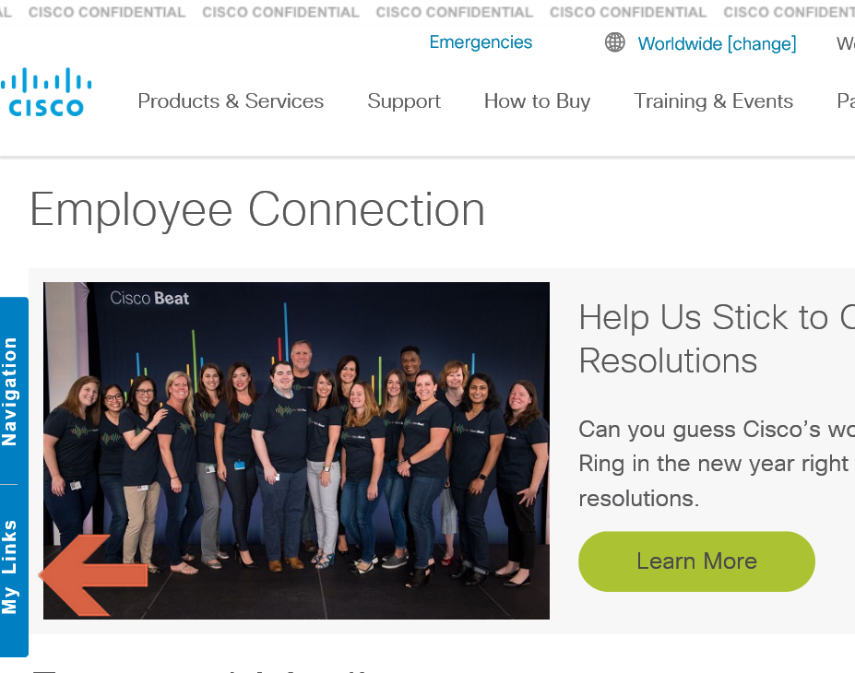
ESS Tool – Navigation to Access the tool
Step’s to Access the ESS Tool:
Step 1 - Connect to CEC Page - http://wwwin.cisco.com/c/cec/index.html
Step 2 - Select “My Links” tab on the left side (Ref shared image)
Step 3 - Select PTO / Payroll Tools from the drop down Menu
Step 4 - Select AsiaPac from the TOOLs Tab
Step 5 - Login with your CEC credentials
Step 6 - Update Bank Information only, follow the instructions in the next slide

Slide 3
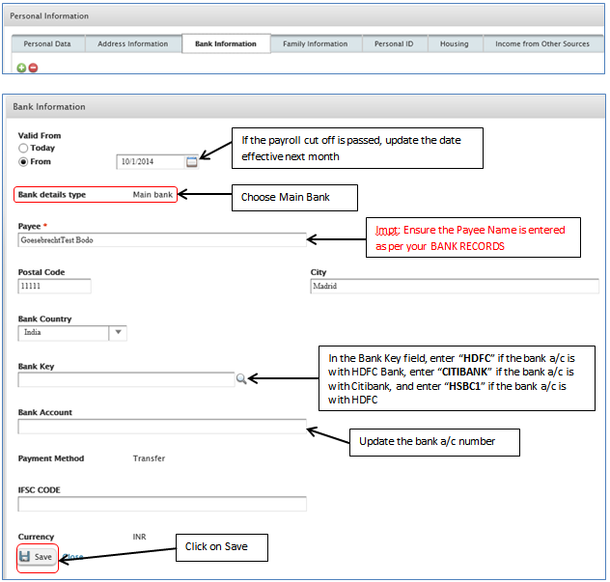
ESS – Update Bank A/c Number
Go to Myself → Personal Information → Bank Information → Click on + button

